Slide 1
Language Barrier Reduction AND Technology upscaling

Slide 2
CONTENTS
Introduction
Problems
Solutions
Costs and Benefits

Slide 3
Question
How can Microsoft and The Canadian Government use technology to upscale workers?

Slide 8
BILANG Built-in Interoperable Language-Agnostic Name Generator

Slide 9
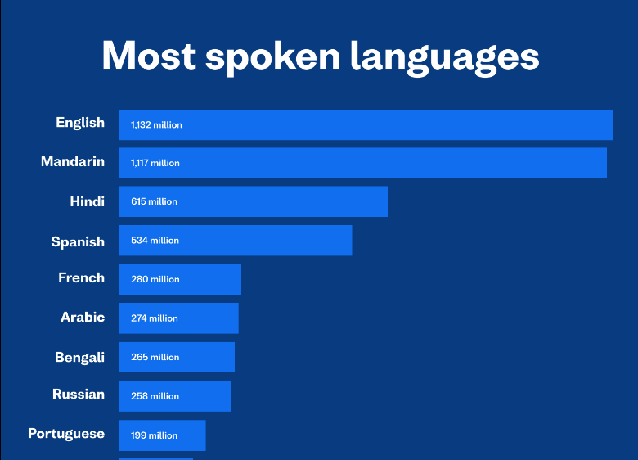
Step 1
Gather Data on Different Languages (words in English with it’s equivalent in a foreign language)

Slide 10
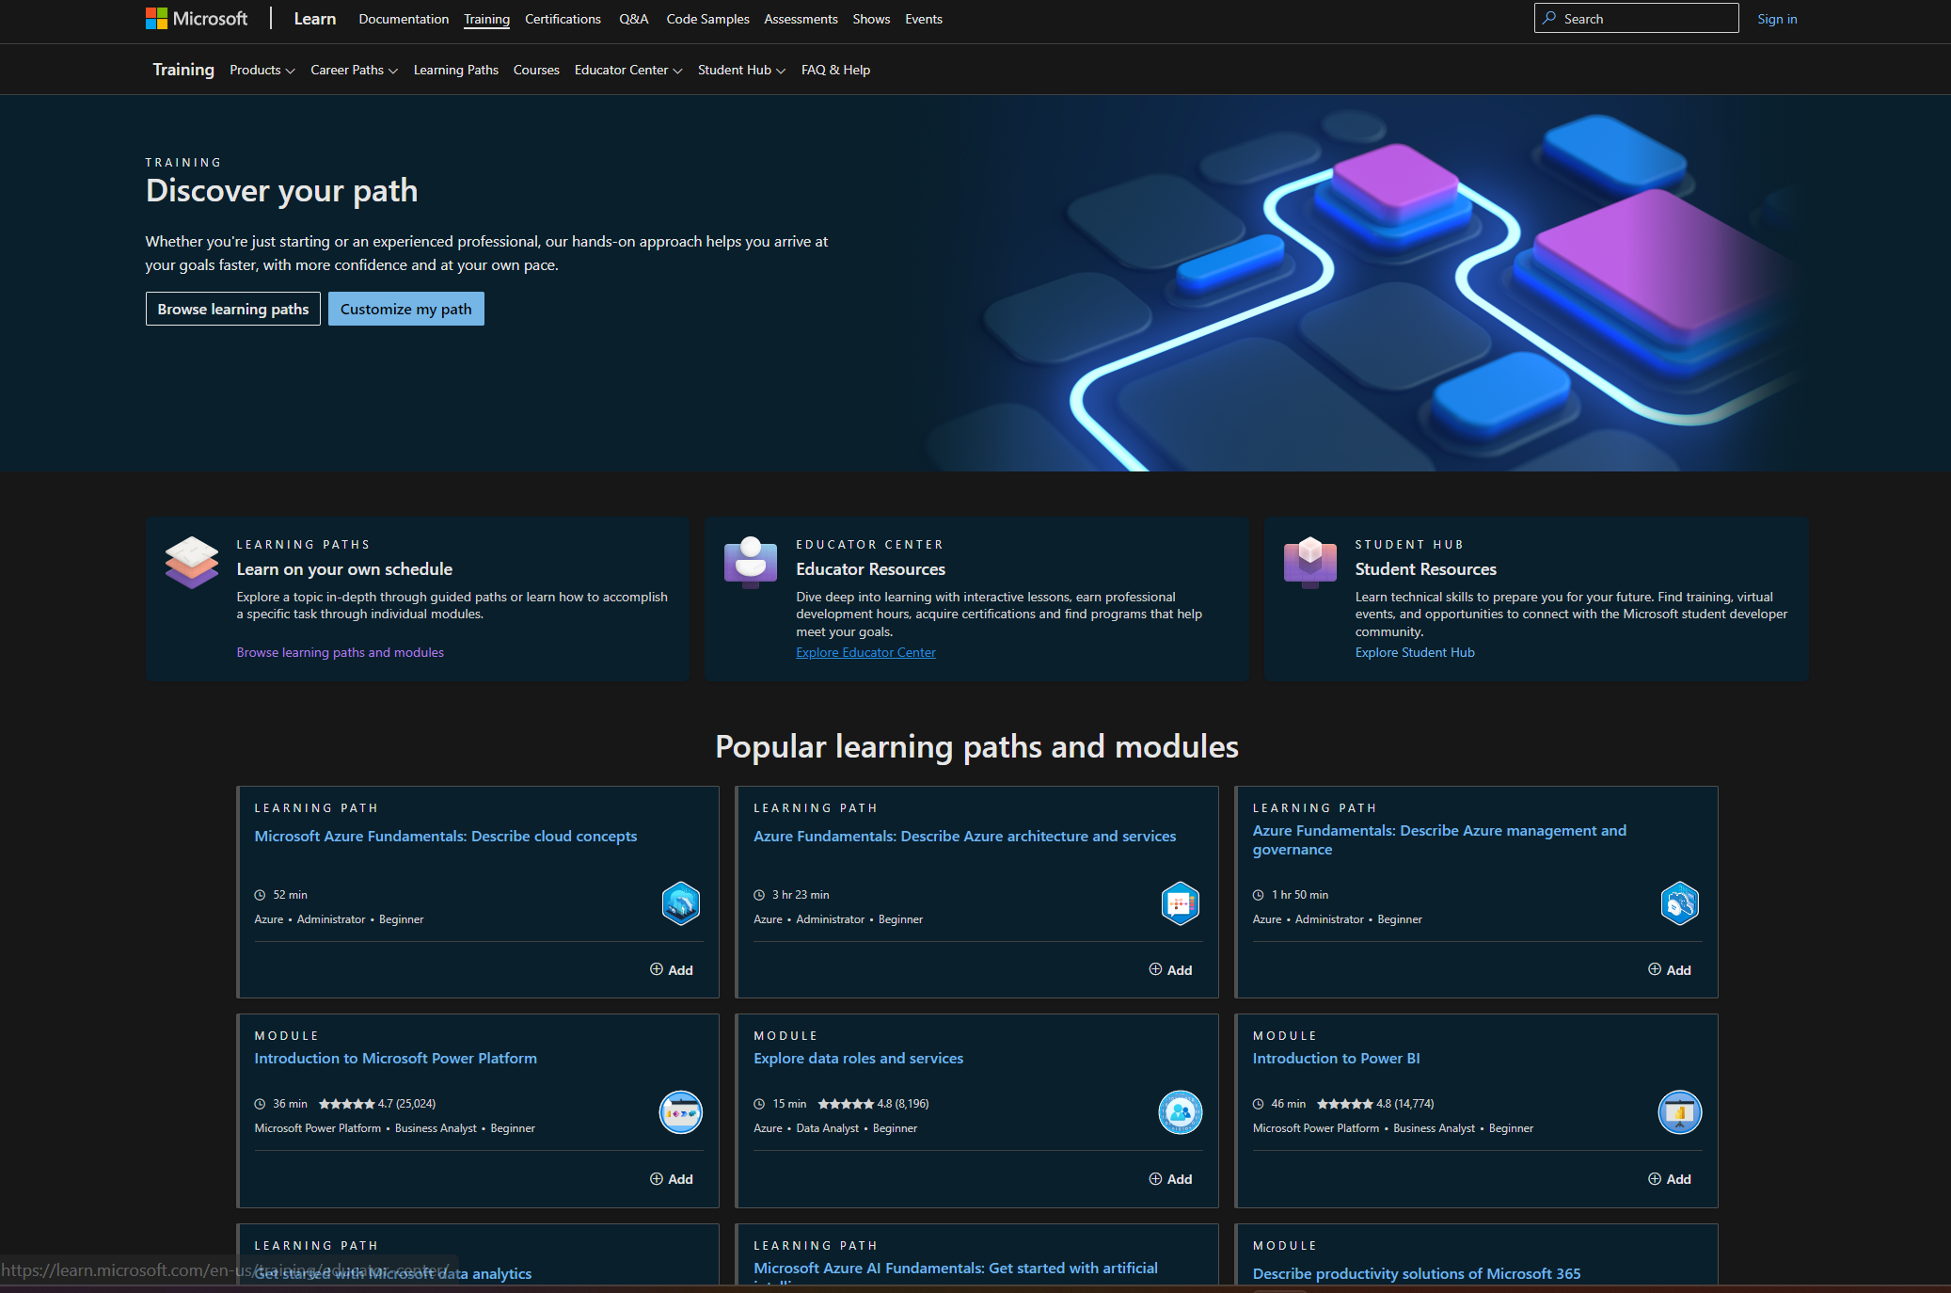
Step 2
Allow for Microsoft Learn to have versions in Different Languages (including code)

Slide 11
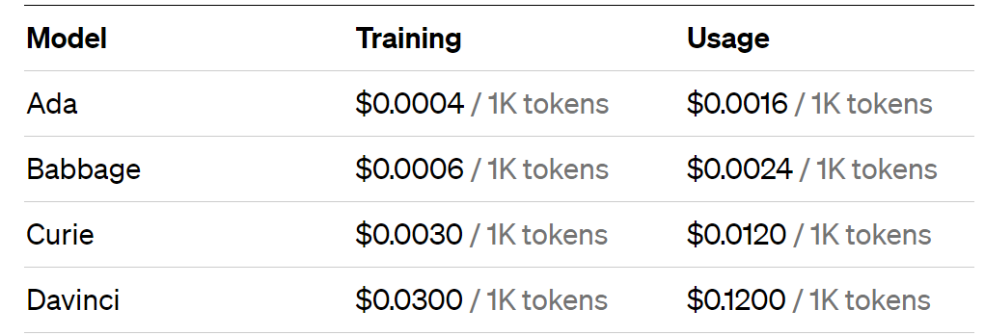
Step 3
Fine-tune a generative AI model on translations between non-English written languages and code

Slide 12
Step 4
Use the translation AI to create natural IntelliSense suggestions and translate the code into English at compile time.
Free extension to provide functionality of translating the code into another language for editing, and then translation back into the original file language.

Slide 13
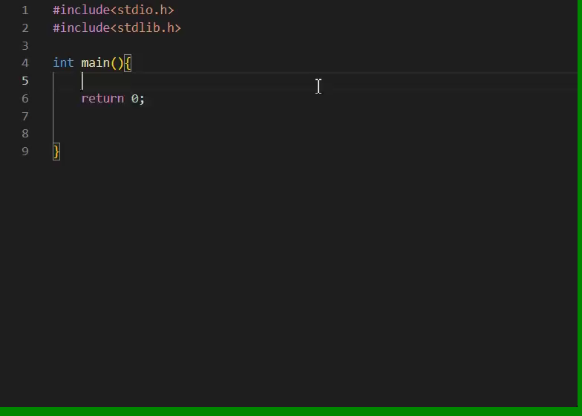
A demonstration of pre-existing intellisense:

Slide 14
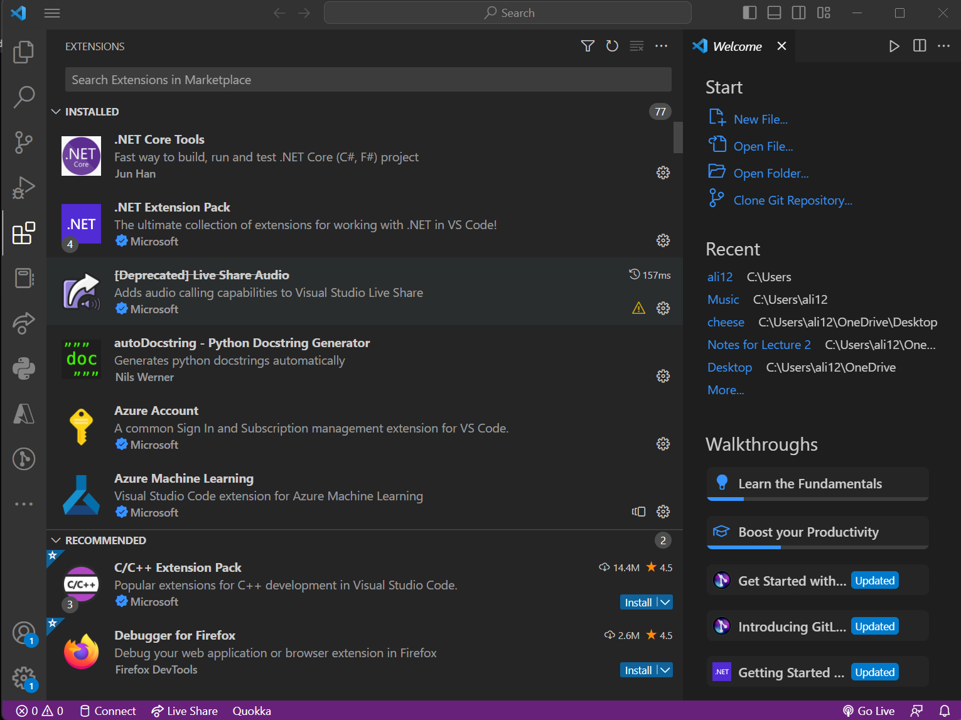
Step 5
Publish the translator on the VS Code Marketplace
as an extension for free use by the public

Slide 15
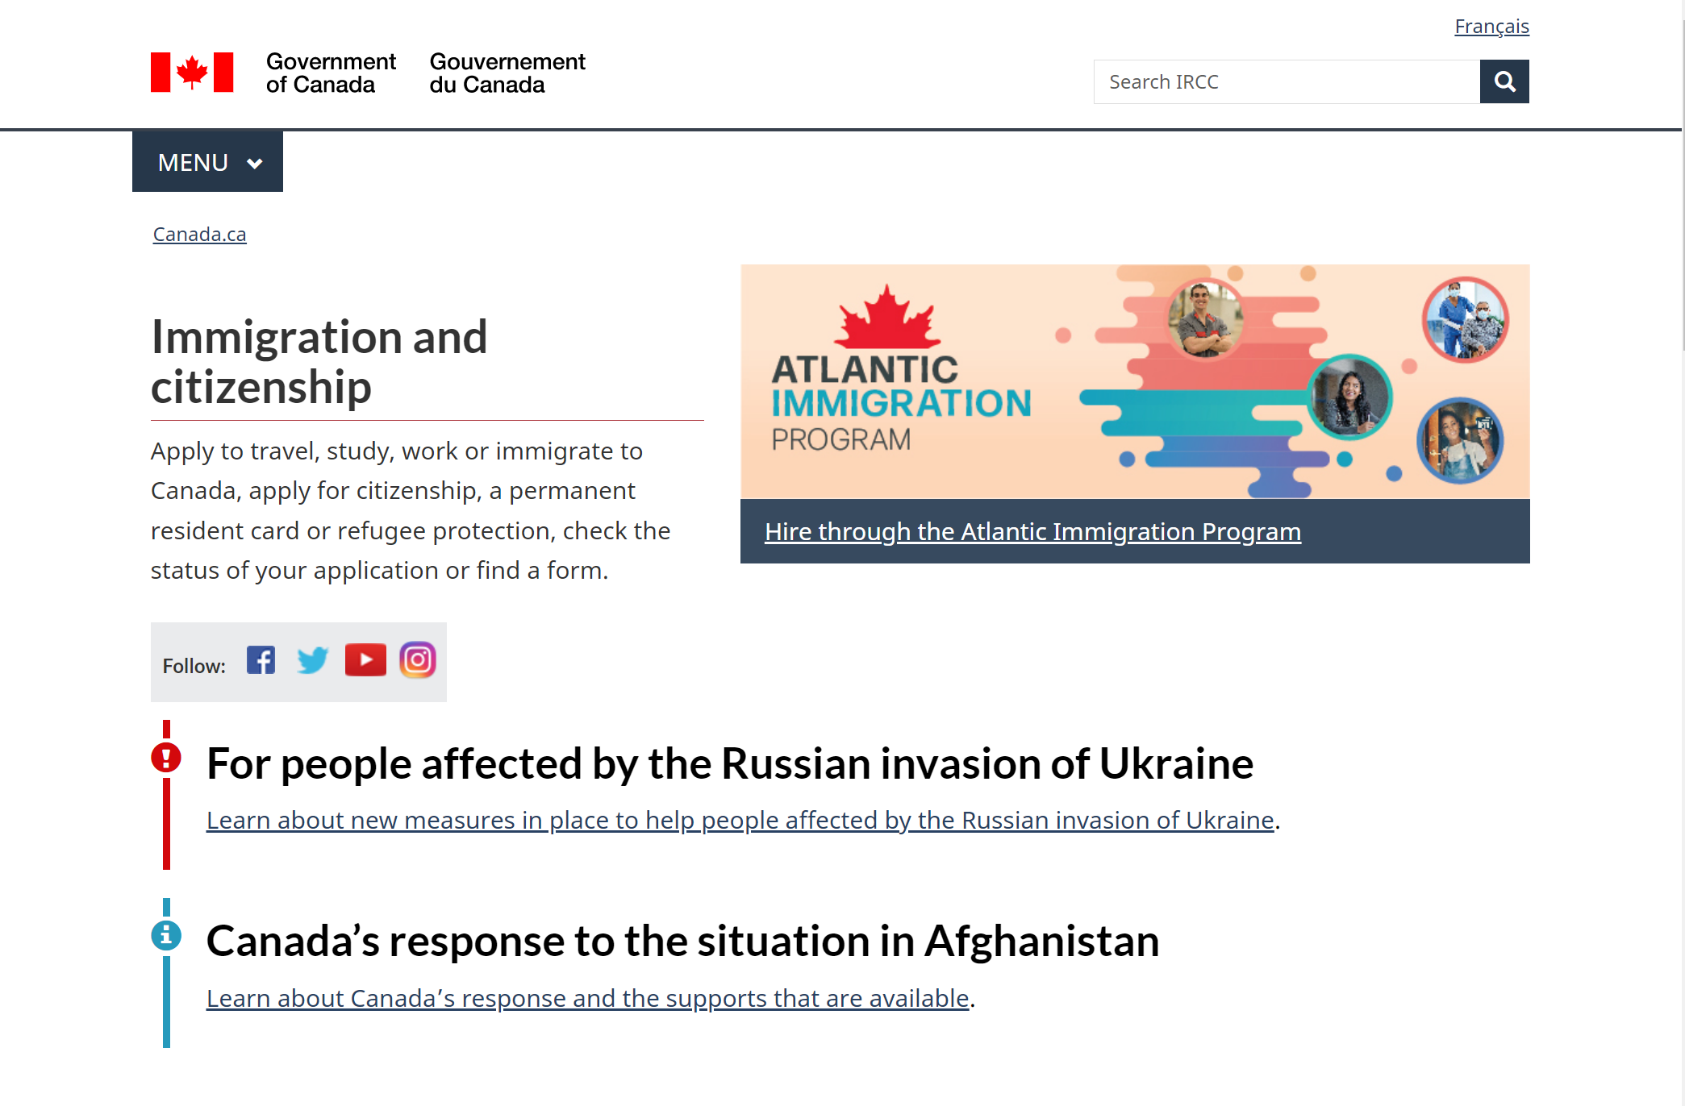
Step 6
Market the extension on Microsoft Learn and Canadian Government Websites, to promote inclusive learning in Computer Science

Slide 16
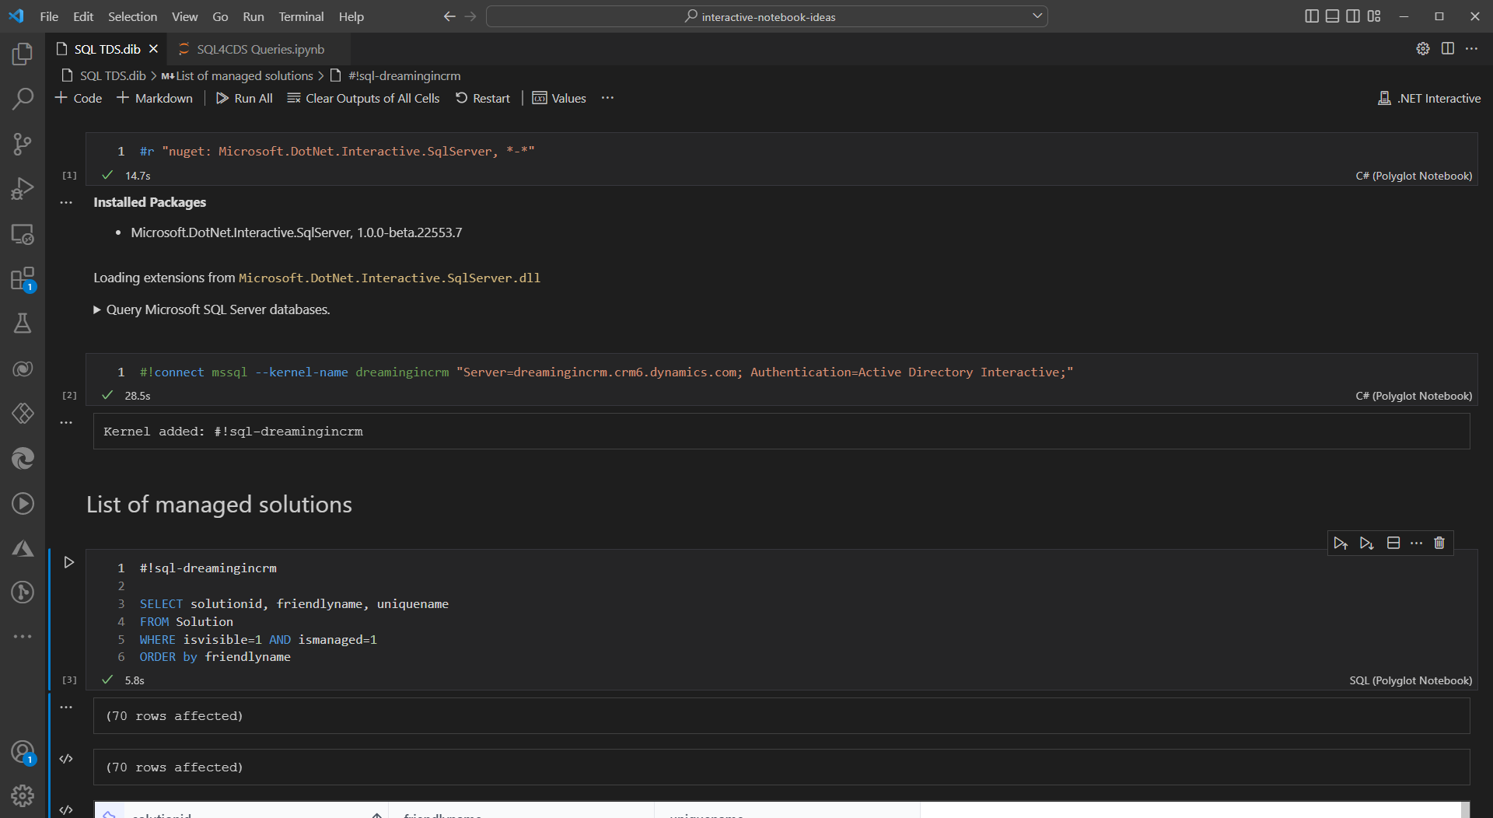
Step 7
Grant businesses and consumers a premium version for added features.
Premium extension would generate hard-coded translation maps for entire libraries
Increases reliability and speed up both IntelliSense suggestions and compilation
Provide a Polyglot Notebooks driver for supporting multiple written languages in the same file.

Slide 17
Proposed Versions of c# in different languages
System.Console.WriteLine(“Hello World”);
Sistema.Consolle.ScriviRiga("Ciao Mondo")
Sistema.Consola.EscribirLínea("Hola Mundo")
प्रणाली।सांत्वना देना।लाइन लिखें ("हैलो वर्ल्ड")
نظام . وحدة التحكم. اكتب الخط ("مرحبا بالعالم") ؛
系统 .安慰 .写线(“你好世界”)

Slide 18
Premium extension
Available even when demand is high
Faster response times
Priority access with new features
Funds free edition

Slide 19
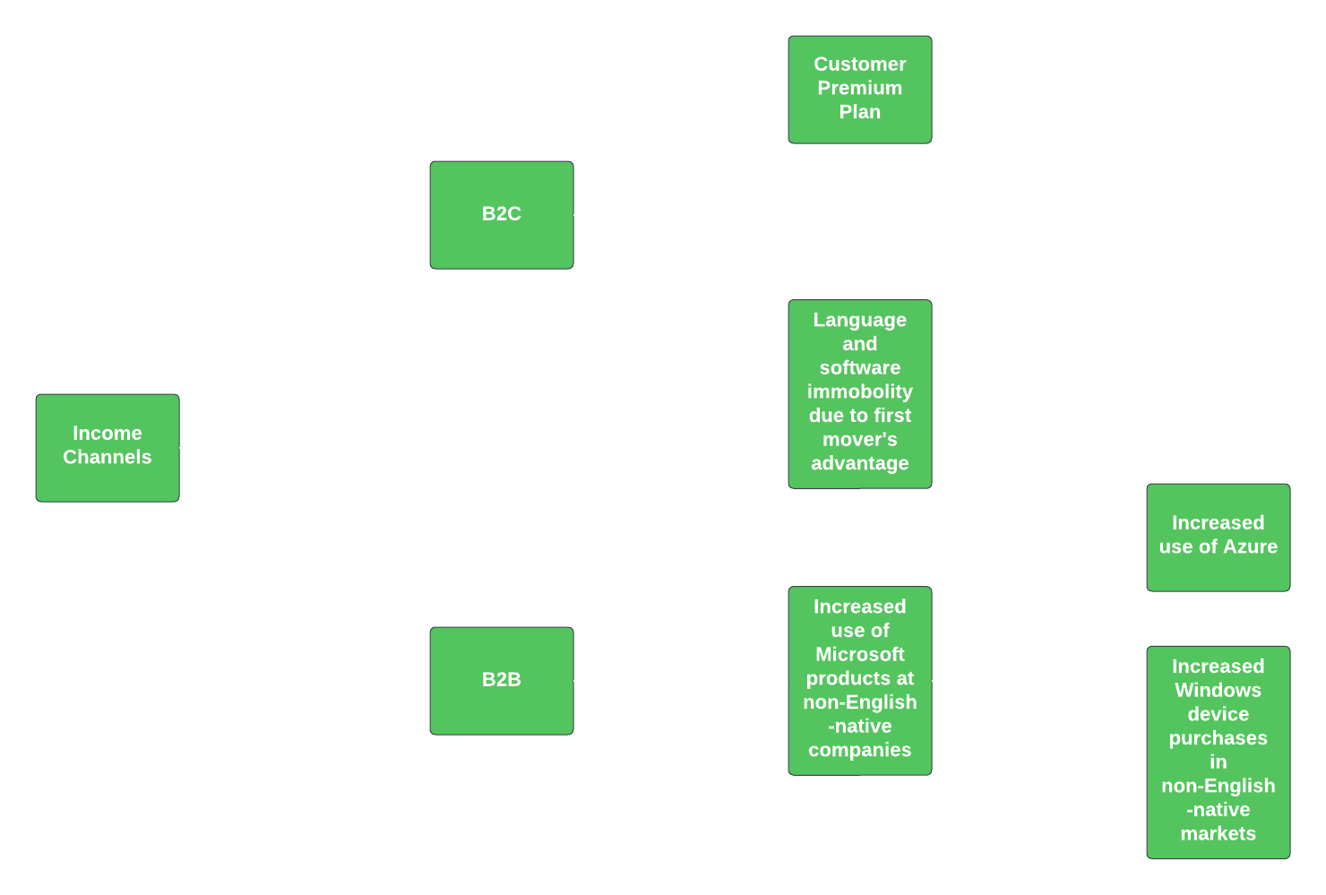
Methods of income

Slide 20
Other benefits:
Older people may be allowed to code, forgoing the barrier of learning a new language, resulting in an increase in market share, as well as, number of demographics targeted.
This extension may make Microsoft’s products more favourable to non-English-native regions if their native languages can be used in code.
Microsoft and foreign companies it’s chooses to partner with may experience less language barriers for projects that require horizontal integration.

Slide 21
Potential Costs
Data acquisition, preprocessing, and quality assurance may be expensive and volatile due to syntactical and semantic differences between languages, and inconsistencies between dialects.
The high cost of computation resources required to train a custom model, if needed, including but not limited to specialised hardware (i.e. GPUs and NPUs) and powerful processors.
Difficulty in developing efficient optimisation models and model architecture, if a custom model is needed.
Potential need for linguists to rectify incorrect use of languages.
Complex and time-consuming testing story.
Marketing costs associated with informing consumers of the new extension.

Slide 22
Breakeven point
According to calculations done, even if Microsoft would have 50 percent of their active current coders install this extension and manage to have 11.5 million new users-created by the new features of the extension (which is a gross underestimate).
Breaking even would require said users to subscribe to the premium service for only 5 dollars a month for 8 months to absolutely break even.

Slide 23
Profit CONDITION
The competitive advantage of BILANG is guaranteed; in the case where fine-tuning a GPT model, such as Instruct DaVinci, is impractical for this use case, the training of a new model is still relatively cheaper for Microsoft as a first-mover in this sector due to it's significantly discounted costs versus what the competition would have to pay to achieve the same functionality, whether or not they use Microsoft services; therefore, if the userbase of BILANG has even a x% chance of becoming a paying user of a Microsoft product, they will make a profit

Slide 24
Excluded factors in the breakeven
The breakeven point excluded some potential profit channels.
all potential B2B prospects which are likely to increase due to a potential increase in Azure users as mentioned in the Methods of Income slide.
all users (Non-native-English) who may purchase Windows devices to enjoy the features.
Decreased cost occurred due to lower training time needed to teach code.
All individuals who feel like learning new languages may be difficult who will begin to code

Slide 25
“Evolving a culture of inclusion can be particularly urgent—and necessary—when an organization experiences dramatic growth”
(Microsoft Diversity and Inclusion Report 2022)

Slide 26
THANK YOU

